Slide 1
Customer-Based Corporate Valuation II:
Modeling Overall Customer Base Activity
Daniel McCarthy

Slide 2

Recall how CBCV works
Acquisitions
Acquisitions
Acquisitions
Date
Q1
Q2
Q3
Customers
Churn
Churn
Purchase frequency, basket size
Sales
$100
$200
$350
Contribution margin, CAC, fixed costs, balance sheet effects
Free Cash Flows
$50
$100
$175
WACC
PV(FCF’s)
$49
$48
$171
NPV(FCF’s)
$368
Non-Operating Assets, Debt, Shares Outstanding
E(Stock Price)
$25
Specify generative models for acquisition, retention, ordering, and spend
Notes:
Implicitly assumes the underlying valuation method is DCF… but works with ~any other valuation method “for free”

Slide 3
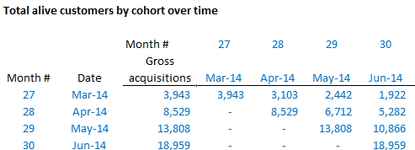
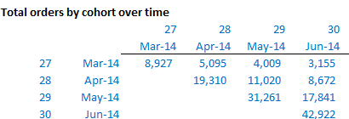
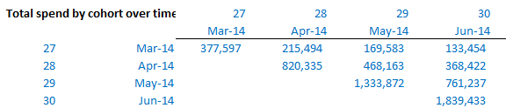
Translating framework into data
Acquisition
Retention
Ordering
Spend

Slide 4
Simplifying assumptions for today’s lecture
Assume:
Subscription firm
Customers are acquired at the end of each quarter
Revenue is generated at end of each quarter
Cohorted customer data and total revenue data are available
Focus on uncovering unit economic insights (retention and spending)
Assuming acquisitions are given
May be most valuable output anyways!
Notes:
Not just one cohort!
Draw picture of timing of acquisition and revenue.
0, 1, 2, …
Lines at 1, 2, “acquisitions(q1)”, “acquisitions(q2)”,…

Slide 5
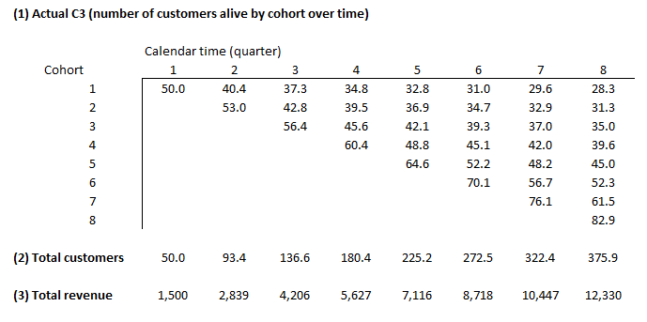
The Data

Slide 6
Modeling retention across cohorts
Set up expected cohorted customer data as function of parameters
Estimate retention parameters
Can be cohort-specific, or over all previous cohorts (may be necessary when data is more limited)
One model for all previous cohorts: necessary when data is more limited
Let’s run the numbers a few ways…
Notes:
Pull up spreadsheet to show column sums
Cohort-specific model off the C3
One model off the C3
Modeling off of total customers instead of the C3

Slide 7
Modeling total revenue
Set up expected ARPU data as function of parameters
Convert expected ARPU into expected revenue
Estimate spend parameters by minimizing difference between actual and expected revenues

Slide 8
Extracting cohort-level unit economics
Required assumptions:
Discount rate
Variable margin
CAC for each cohort

Slide 9
What about acquisitions?
Two general approaches:
[Marketing spend] x [CAC] = [Acquisitions]
If inside company, marketing spend is known
Assume CAC → Acquisitions
[Acquisitions] directly
Use statistical model to project acquisitions
Assume CAC → Marketing spend
We will stick with approach 1 in this class
Notes:
Cross out acquisition, replace with prospect
Cross out ChurnTime=t, replace with AcquisitionTime=t
Cross out E(% Alive), replace with Cumulative % of prospects acquired
P(AcqTime) moves up not down. sBG can’t have an increasing P(acquisition) – at best flat.

Slide 10
Further extending the framework
Non-subscription firms? Use the BG/BB instead of sBG
Other/different data? Change “SSE” that we estimate parameters from
Covariates?
Cohort-specific and/or time-varying ARPU and margin trends?
~Simple extensions of the statistical model
Notes:
Replace vector ARPU and scalar margin % with matrices
Simple pictorial description

Slide 11
Lessons
Modeling overall customer base activity isn’t that much worse!
Use all the same tools, but run models across cohorts, then sum across those cohorts

